Slide 1
Lanthanides and Actinides
The lanthanides are the elements produced as the 4f sub level is filled with electrons and the actinides are formed while filling the 5f sub level

Slide 2
The two rows that are generally placed underneath the main periodic table are called the lanthanides series and the actinides.
Therefore this block of elements are referred to as the f block. The lanthanides are also occasionally referred to as rare earth elements.

Slide 3
The f-block elements in which the last electron or the differentiating electron enters in (n-2) f-orbitals and the general electronic configuration is (n-2)f¹⁻¹⁴ (n-1)d⁰⁻¹ ns² consists of two series of inner transition elements
Lanthanides (the fourteen element following lanthanum) he elements in which the last electron enters one of the 4f-orbitals are called 4f-block elements or first inner transition series.
They are also called Lanthanides (or) lanthanones because they come immediately after lanthanum.
Â·

Slide 4
Actinides (the fourteen element following actinium)
The elements in which the last electron enters one of the 5f-orbitals are called 4f-block elements or second inner transition series. They are also called Actinides because they come immediately after actinium. The general electronic configuration is [Rn]5f¹⁻¹⁴ 6d⁰⁻¹ 7s²

Slide 5
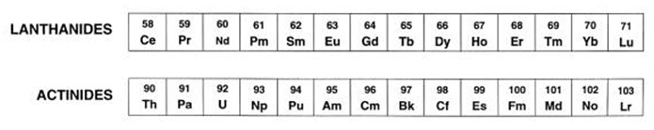
Lanthanides (58Ce- 71Lu)
General Characteristics
Some important characteristics are given below-

Slide 6
Some important characteristics are given below-
1. Electronic Configuration of Lanthanides:
The complete electronic configuration of Lanthanides can be given as 1s² 2s² p⁶ 3s²p⁶d¹⁰4s²p⁶d¹⁰f⁰⁻¹⁴ 5s²p⁶ d⁰⁻¹ 6s².
2. Oxidation States: The most stable oxidation state of Lanthanides is +3. They also show +2 and +4 oxidation states due to the presence of either half filled or completely filled or empty 4f sub shell.
3. Color: Many of lanthanide metals are silver white. The lanthanide ions with +3 oxidation state are colored both in solid state and in aqueous solution. The color of a cation depends on the number of un
4.Magnetic Properties: The lanthanide ions other than f⁰ and f¹⁴ type are paramagnetic in nature due to unpaired electrons in f-orbitals.
5. Melting and boiling point: They have fairly high melting point but there is no definite trend in the melting and boiling point of lanthanides.
6.Density: They have high density ranging between 6.77 to 9.74 g cm-3. Its increases with increasing atomic number.
7. Ionization enthalpies: They have low ionization enthalpy.
8. Complex formation: They don't have much tendency to form complexes because of low charge density. The order of complex formation can be best represented as Ln⁴⁺ > Ln³⁺ > Ln²⁺.
9. Reactivity: All the lanthanides show the same electronic configuration and the +3 oxidation states, they show similarity in the reactivity which is greater than the transition elements. This is due to shielding of the unpaired electrons of the inner 4f-orbital by the outer 5s, 5p, and 5d orbital's. Due to the small change in the size of the ions, they show great similarity in their chemical properties. The first few members are quite reactive. A few properties are given below. paired f electrons.

Slide 7
Define Lanthanide Contraction
"The steady decrease in the values of the radii of M³⁺ cations in the lanthanide series is called as Lanthanide contraction. The 4f-electrons constitute inner shells and are rather ineffective in screening the nuclear charge. Thus, there is a gradual increase in the effective nuclear charge experienced by the outer electrons. So the attraction of the nucleus for the electrons in the outermost shell increases as the atomic number increases and the electron cloud shrinks.
Cause of lanthanide Contraction.“-
the nuclear charge (i.e, atomic number) increases by +1 for each element and the addition of the extra electron takes place in the 4f orbital. the shielding of one electron in 4f orbital by the one residing in the same orbital is very poor. Due to the negligible amount of mutual shielding effect between the electrons residing in 4f orbital, the increase in nuclear charge by +1 for each element in the lanthanide series brings the valence shell nearer to the nucleus and hence the size of M³⁺ cations goes on decreasing as we move from one element to the next one in the series.
lanthanide contraction plays a significant role in the chemistry of lanthanides. The important consequences of it are:
There is a steady decrease in the ionic size.
There is a slight increase in electronegativity of the trivalent ions.
The Eº values for M³⁺ + 3e → M_{(g)} increases regularly from lanthanum - 2.52 V to 2.25 V for lutetium.

Slide 8
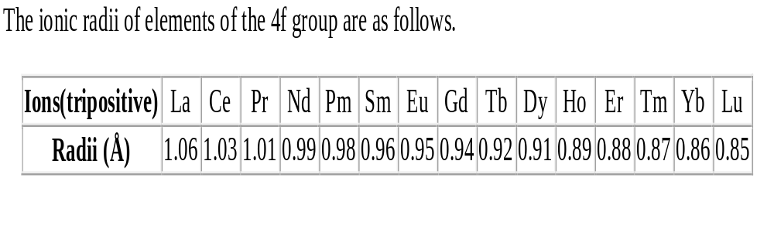

Slide 9
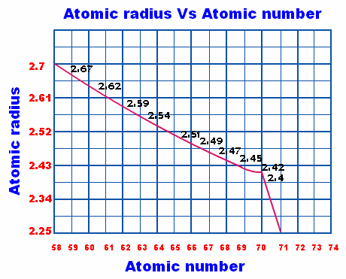

Slide 11
Actinides
General characteristics of Actinides
Electronic Configuration: All the actinides have common 7s² configuration and variable occupancy of 5f and 6d sub shells. The general electronic configuration of actinium is [Rn] 5f⁰⁻¹⁴6d⁰⁻² 7s² where, Rn is the electronic configuration of the element Radium. The irregularities in the electronic configuration are related to the stabilities of half filled or full filled orbitals (f⁰, f⁷, f¹⁴ ).
Oxidation States: Unlike lanthanides, actinides show a variety of oxidation states from +3 to +6 due to the very small energy gap between 5f, 6d and 7s sub shells. The principal oxidation states are +3 and +4. The +3 oxidation state is the most stable. The +4 oxidation state is the most stable in Th and Pu. +5 in Pa and Np and +6 is seen in U. In actinides, the distributions of oxidation states are uneven.
Complex formation: The degree of complex formation decreases in the order. M⁴⁺ > MO₂⁺² > MO⁺² where, M is an element of the actinide series. There is a high concentration of charge on the metal atom.
Melting and boiling point: They have high melting and boiling points like lanthanides but don’t show any regular trend with increasing atomic number.
Density: All actinides except thorium and amercium have high density.
Electropositive character: These metals are highly electropositive in nature like lanthanides.
Ionization enthalpies: The actinides have lower ionization enthalpies than lanthanides because 5f is more effectively shielded from nuclear charge than 4f.
Magnetic behavior: All actinides are paramagnetic in nature which depends on the presence of unpaired electrons.
Radioactivity: All are radioactive in nature. First few members have relatively long half lives but the remaining have half-lives from a few days to a few minutes.
Color of the ions: Actinides ions are generally colored due to f – f transitions. It depends upon the number of electrons in 5f orbitals.
Chemical behavior: They are highly reactive metals in fine state and a strong reducing agent. A few properties are given below.
They react with boiling water to give oxide and hydride.
They combine with most of the non-metals at moderate temperature.
All these metals are attacked by HCl acid but the effect of nitric acid is very small.

Slide 12
Actinide Contraction
The size of atoms or M⁺³ ions decrease regularly along the actinides series with increase in atomic number from Th to Lr. The steady decrease in ionic radii with increase in atomic number is referred to as actinide contraction just like lanthanide contraction.
The reason of this contraction is the poor shielding effect of 5f electron by another in the same shell which increases the effective nuclear charge and thus contraction in size of the electron cloud. This is because 5f orbitals extend in space beyond 6s and 6p orbitals whereas, 4f orbitals are buried deep inside the atom.

Slide 13
Similarities Between Lanthanides and Actinides
1. Both lanthanides and actinides involve the filling of f-orbitals.
2. Both exhibit a common oxidation state of +3.
3. Both are electropositive and very reactive.
4. Both exhibit magnetic and spectral properties.
5. Lanthanides exhibit lanthanide contraction and actinides exhibit actinide contraction

Slide 14
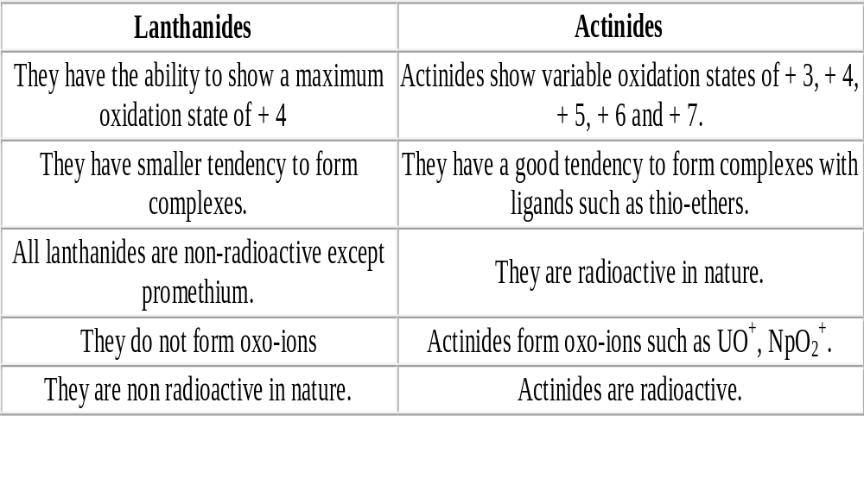
Difference Between Lanthanides and Actinides

Slide 15
Uses of Lanthanides
The important uses of lanthanides are given below.
They don’t find any use in their pure state. They are used in the production of alloys of steel to improve the strength and workability of steel. A well known alloy is mischmetal which is used in making magnesium based alloy (Mg mixed with 3% of mischmetal). This is a pyrophoric alloy which is used in making bullets, shells and lighter flints.
Their oxides are used in the glass industry for polishing glass and making colored glass for goggles and television screens.
Mixed oxides of lanthanides are used in petroleum cracking.
Due to their paramagnetic and ferromagnetic nature, they are used in magnetic and electronic devices.
Ceric sulphate is a well known oxidizing agent which is used in volumetric analysis.

Slide 16
Uses of Actinides
The most useful actinides are thorium, uranium and plutonium.
Thorium is used in the atomic reactors and in the treatment of cancer. Their salts are used in making incandescent gas mantles.
Uranium is used as nuclear fuel. Their salts are used in the glass industry for imparting green color, ceramic industry, textile industry and in medicines too.
Plutonium is also used as nuclear fuel and for making atomic bombs.

Slide 17
Monazite
Monazite is a reddish-brown phosphate mineral containing rare earth metals. Monazite has a general formula of
(La,Ce, Nd, Sm)PO4
Pr, Sm, Eu, Gd, and Y substitute for La, Ce, and Nd
The dominant rare-earth element in a particular monazite is denoted by the atomic suffix. Four different kinds of monazite, depending on relative elemental composition of the mineral:
monazite-Ce (Ce, La, Pr, Nd, Th, Y)PO₄
monazite-La (La, Ce, Nd, Pr)PO₄
monazite-Nd (Nd, La, Ce, Pr)PO₄
monazite-Sm (Sm, Gd, Ce, Th)PO₄
In addition to above , ( 35% Ce ₂ O ₃ , 35% La ₂ O ₃ , and 30% P ₂ O ₅ ).

Slide 18
Monazite can be isolated as a nearly pure concentrate by the use of gravity, magnetic, and electrostatic separation.

Slide 19
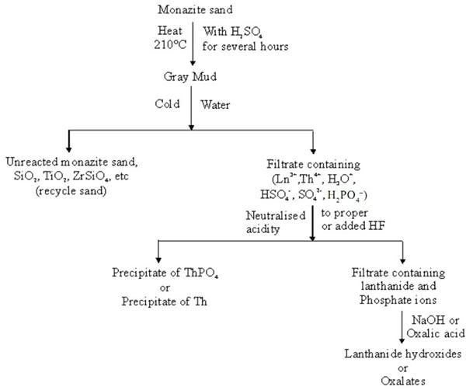
Extraction of Lanthanides from Monazite Sand:
Acid opening

Slide 20
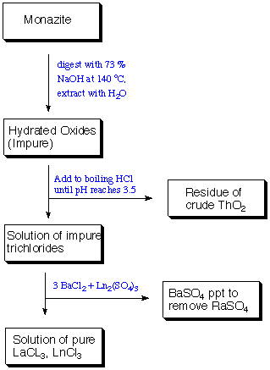
Alkaline opening

Slide 21

Separation of the Elements
Two Methods
1. ion exchange chromatography
Ln³⁺(aq) are strongly adsorbed by a cation-exchange resin
Add an eluant ligand
typically chelating ligands
EDTA
or 2-hydroxy-EDTA
Ligand binds most strongly to smallest ion
e.g. the binding constants of the Ln(EDTA) complexes

Slide 22
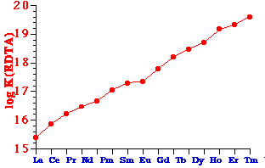
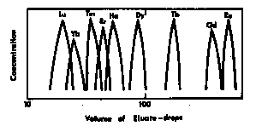
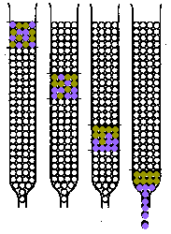
The process of separation is indicated graphically

Slide 23

2. Solvent Extraction
Ln³⁺(aq) is extracted in a continuous counter-current process into a non-polar organic liquid (e.g. kerosene)
the kerosene contains ca. 10% of
bis(2-ethylhexyl)phosphinic acid (DEHPA)
  tri-n-butylphosphine oxide (TBPO) (^{n}Bu₃O)₃PO
solubility of Ln³⁺ in organic solvent increases with its RAM
separation factor for adjacent rare earths = 2.5
Automatic multistep, counter-current conditions Æ 99.9% purity Ln

